Slide 1

Faculty of Science & Technology
Jagran School of Computer Applications
Major Project Presentation
JLU ORBIT
UNDER SUPERVISION OF :
Dr. Dileep Kumar Singh
Professor & Head
JSCA, JLU Bhopal
SUBMITTED BY :
Mradul Yadav (2023BCAH031)
Naman Sah (2023BCAH034)
Samuel Dennis David (2023BCAH046)

Slide 2
Outline
Introduction
Importance and Need of Your Project
Contribution & Role of Team Members
Features of your Project
Tools and Technologies
System/User requirements
Diagrams
Snapshots of the system
Conclusion
Future work
References
- Data Flow Diagram
- Schema Chart

Slide 3
Introduction
Addresses the need for efficient internal communication.
Centralized digital ecosystem for JSCA department.
Facilitates structured content publishing.
Empowers faculty to share academic resources.
Promotes active student-faculty engagement.

Slide 4
Importance & Need of Your Project
Information silos across WhatsApp, Instagram, Notice Boards.
Lack of persistence: data becomes difficult to retrieve later.
Students miss time-sensitive messages in cluttered feeds.
Required central, reliable, and easily accessible system.

Slide 5
Contribution & Role of Team Members
Naman Sah (Backend – Integration and Deployment)
Samuel D. David (Frontend – Development, Designing and Testing)
Mradul Yadav (Backend – API Routing and Database Connectivity)

Slide 6
Features of your Project
JWT-based secure authentication.
Rich-text posts with media upload support.
Persistent and searchable digital archive.
Dynamic user interface built with window DOM loading.

Slide 7
Tools and Technologies
Backend: Node.js & Express.js
Database: MongoDB (NoSQL, Mongoose ODM)
Frontend: HTML5, CSS3, Vanila JS
Authentication: JSON Web Tokens (JWT)
Media Handling:Multer and Cloudinary.

Slide 8
System/User requirements
Web Browser: Chrome, Firefox, Edge
Internet Connectivity
Server with Node.js and MongoDB installed
Admin Login Credentials required for content upload

Slide 9
Diagrams
Data Flow Diagram
Schema Chart
1. User Schema
2. Profile Schema
3. Post Schema
4. Group Schema
5. Notification Schema
6. Research Schema

Slide 10
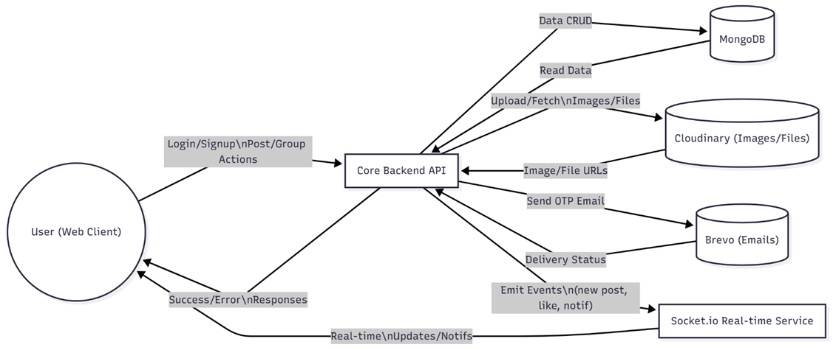
Data Flow Diagram

Slide 11
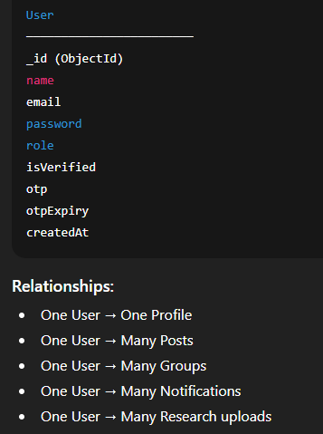
Schema Chart
1. User Schema

Slide 12
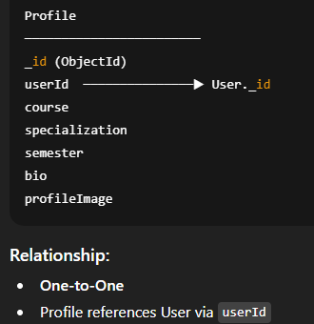
Schema Chart
2. Profile Schema

Slide 13
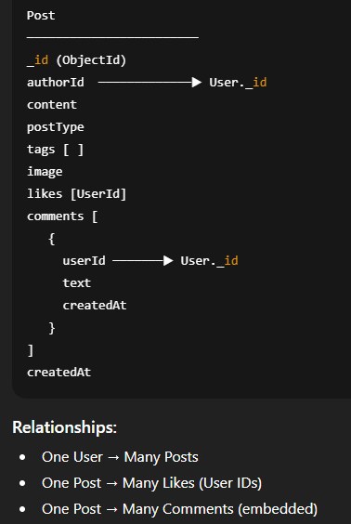
Schema Chart
3. Post Schema

Slide 14
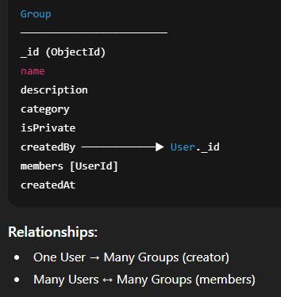
Schema Chart
4. Group Schema

Slide 15
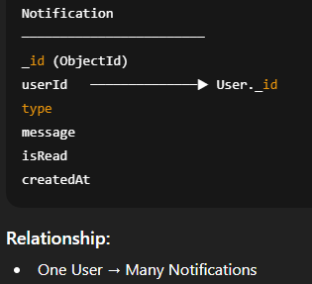
Schema Chart
5. Notification Schema

Slide 16
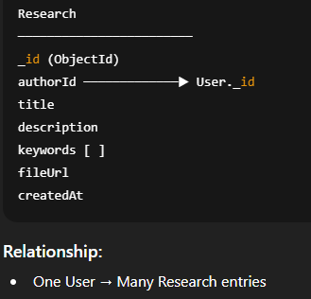
Schema Chart
6. Research Schema

Slide 17
Snapshots of system
Login/Singup Page
Loading Page
Home Dashboard
Create Post Interface
Profile Interface
Groups Tab Interface
Research Tab Interface
Search Page Interface
Developer Page

Slide 18
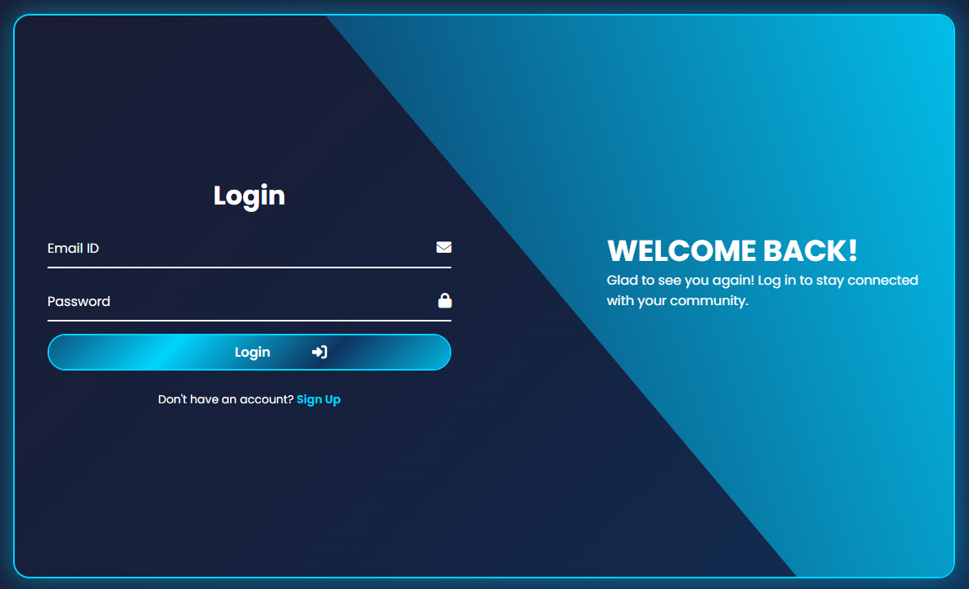
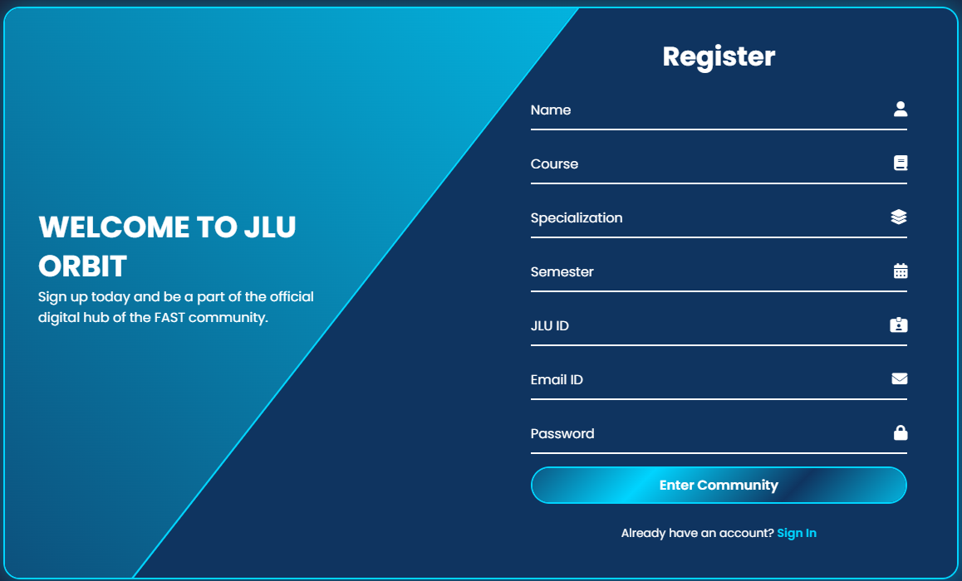
Login/Signup Page

Slide 19
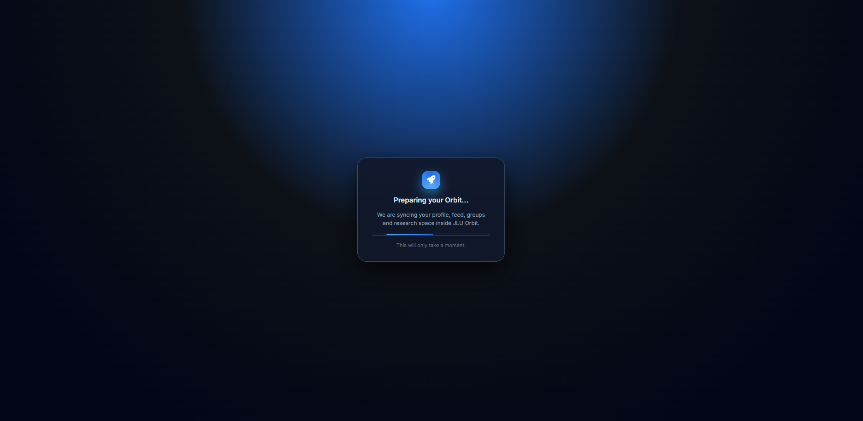
Loading Page

Slide 20
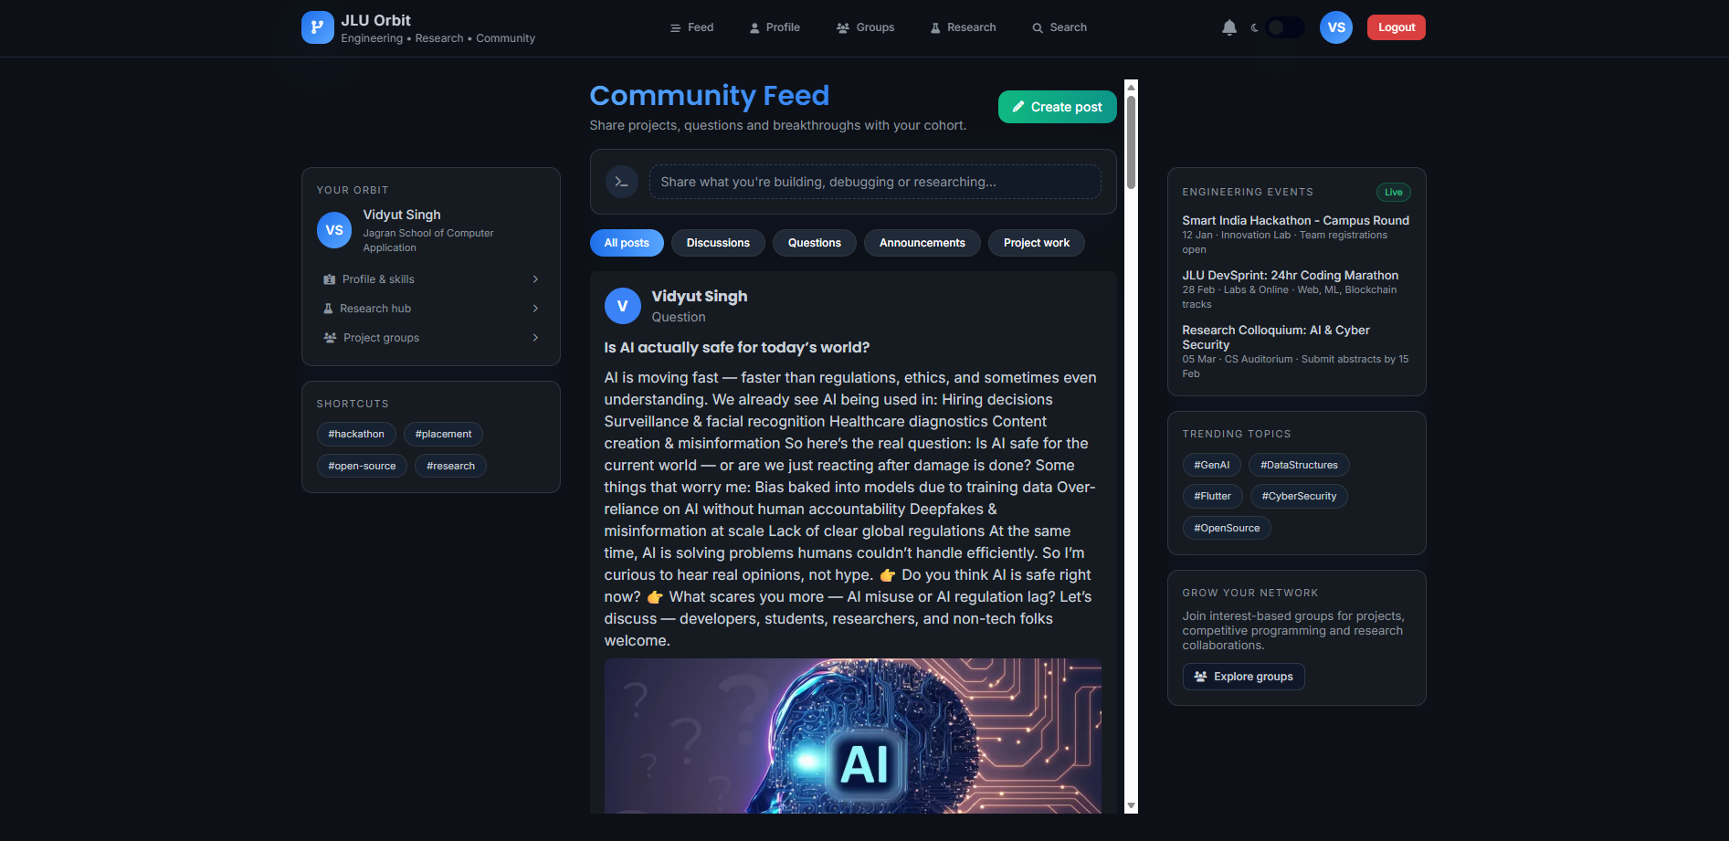
Home Dashboard

Slide 21
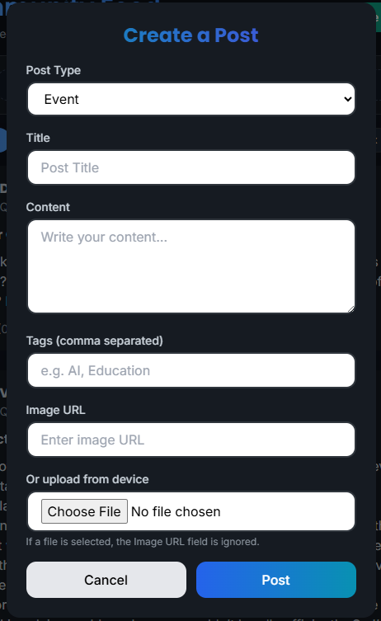
Create Post Interface

Slide 22
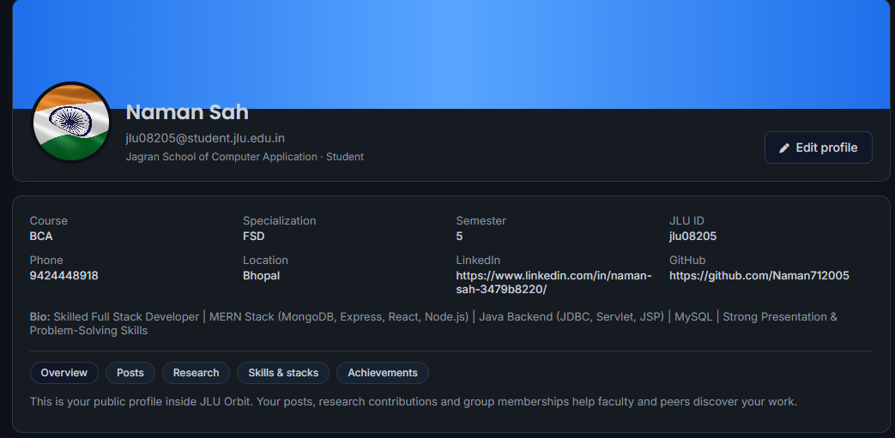
Profile Interface

Slide 23
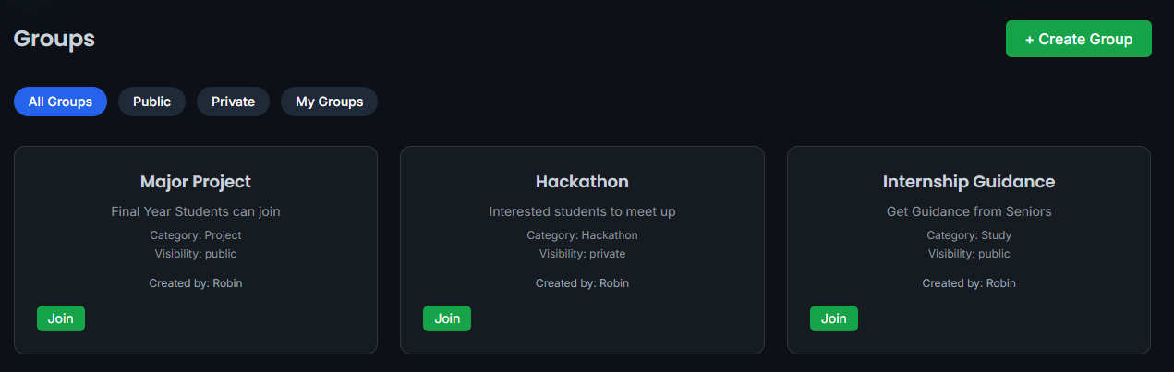
Groups Tab Interface

Slide 24
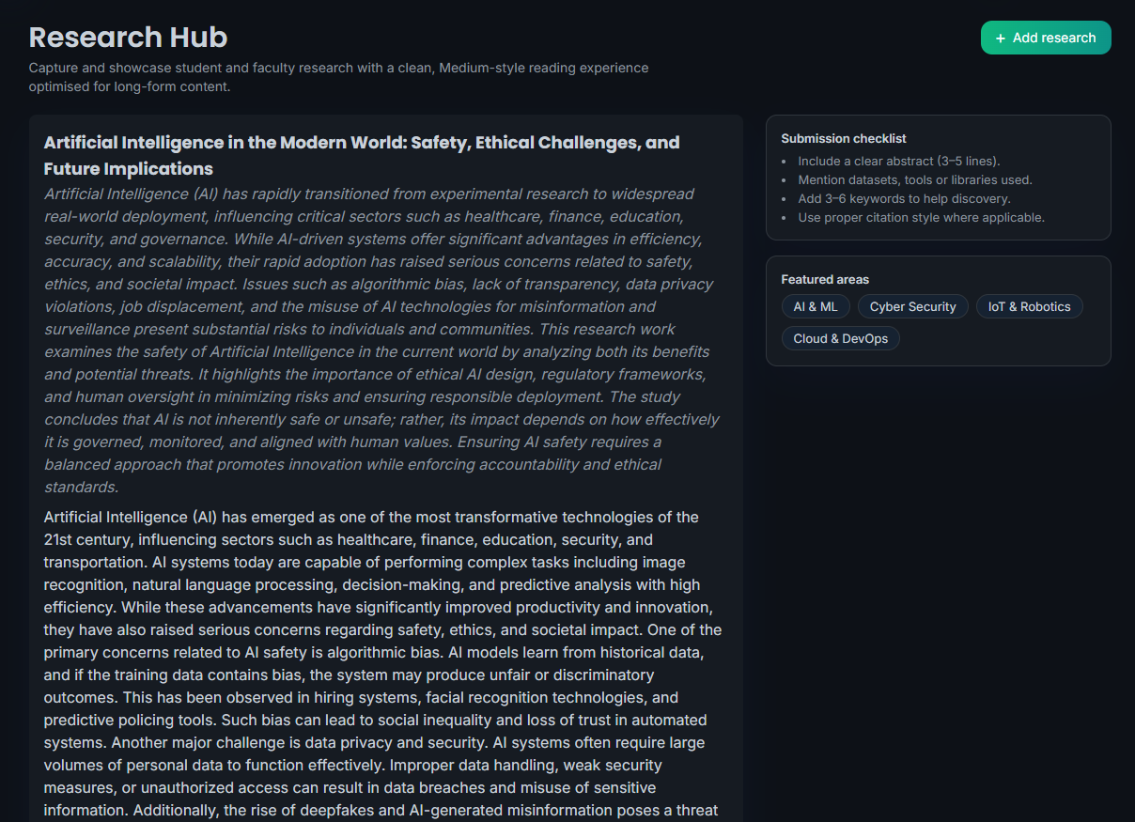
Research Tab Interface

Slide 25
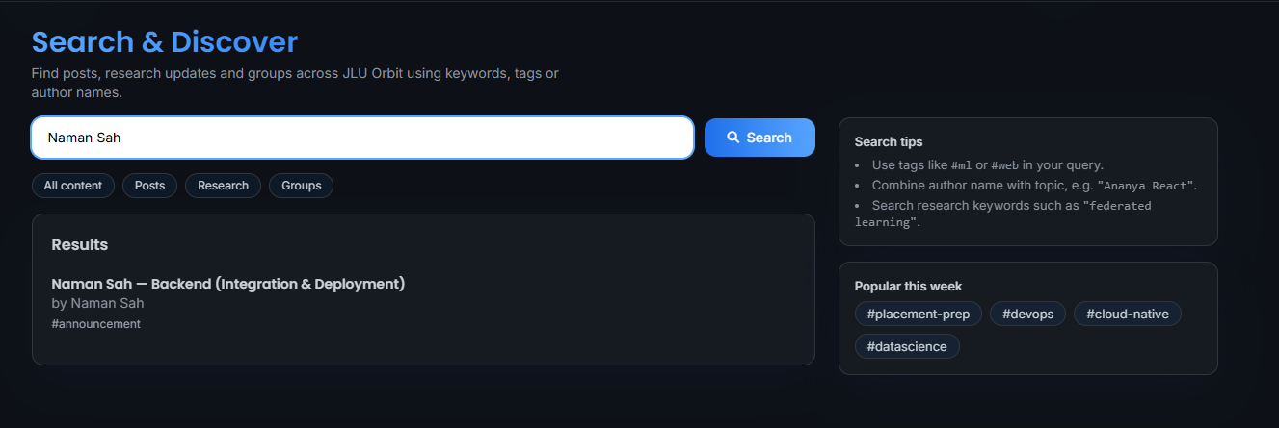
Search Page Interface

Slide 26
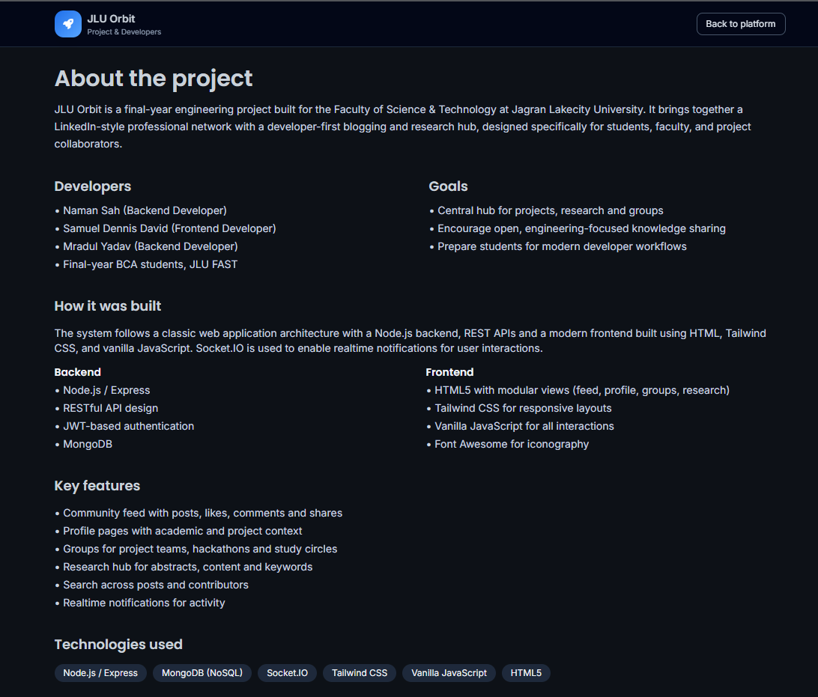
Developer Page

Slide 27
Conclusion
Centralized communication system for JSCA department.
Eliminates reliance on informal and fragmented channels.
Ensures data persistence and reliable information access.
Enhances academic coordination and transparency.

Slide 28
Future Work
Role-Based Access Control for students/faculty.
Advanced search and filtering options.
Analytics dashboard for engagement insights.
Real-Time Chat options in Groups Section.

Slide 29
References
Node.js Documentation: https://nodejs.org/en/docs/
Express.js Routing Guide: https://expressjs.com/en/guide/routing.html
Mongoose ODM Docs: https://mongoosejs.com/docs/
MongoDB Manual: https://www.mongodb.com/docs/manual/
EJS Templating: https://ejs.co/

Slide 30
Thank You

